Slide 1
Chapter 2 Introduction to C++
Starting Out with C++ from Control Structures through Objects, Tony Gaddis, 9th Edition
ENGR 1400 – Dr. Michael E. Olson

Slide 2
2.1
The Parts of a C++ Program

Slide 3
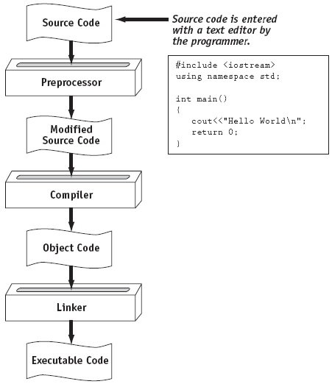
Recall: From a High-Level Program to an Executable File

Slide 4
The Parts of a C++ Program
// sample C++ program
#include <iostream>
using namespace std;
int main()
{
cout << "Hello, world!";
return 0;
}

Slide 5
The Parts of a C++ Program
comment
// sample C++ program
#include <iostream>
using namespace std;
int main()
{
cout << "Hello, world!";
return 0;
}
preprocessor directive
which namespace to use
beginning of function named main
beginning of block for main
output statement
string literal
Send 0 to operating system
end of block for main

Slide 6
Special Characters
Character | Name | Meaning
// | Double slash | Beginning of a comment
# | Pound sign | Beginning of preprocessor directive
< > | Open/close brackets | Enclose filename in #include
( ) | Open/close parentheses | Used when naming a function
{ } | Open/close brace | Encloses a group of statements
" " | Open/close quotation marks | Encloses string of characters
; | Semicolon | End of a programming statement

Slide 7
2.2
The cout Object

Slide 8
The cout Object
Displays output on the computer screen
You use the stream insertion operator << to send output to cout:
cout << "Programming is fun!";

Slide 9
The cout Object
Can be used to send more than one item to cout:
cout << "Hello " << "there!";
Or:
cout << "Hello ";
cout << "there!";

Slide 10
The cout Object
This produces one line of output: cout << "Programming is "; cout << "fun!";

Slide 11
The endl Manipulator
You can use the endl manipulator to start a new line of output. This will produce two lines of output: cout << "Programming is" << endl; cout << "fun!";

Slide 12
The endl Manipulator
cout << "Programming is" << endl; cout << "fun!";
Programming is
fun!

Slide 13
The endl Manipulator
You do NOT put quotation marks around endl
The last character in endl is a lowercase L, not the number 1.
endl
This is a lowercase L

Slide 14
The \n Escape Sequence
You can also use the \n escape sequence to start a new line of output. This will produce two lines of output: cout << "Programming is\n"; cout << "fun!";
Notice that the \n is INSIDE
the string.

Slide 15
The \n Escape Sequence
cout << "Programming is\n"; cout << "fun!";
Programming is
fun!

Slide 16
Common Escape Sequences
Escape Sequence | Name | Description
\n | Newline | Go to the next line
\t | Horizontal tab | Skip to the next tab stop
\a | Alarm | Cause the computer to beep
\b | Backspace | Back up or move left one position
\r | Return | Go to the beginning of the current line
\\ | Backslash | Print the backslash
\’ | Single Quote | Print the single quote ‘
\” | Double Quote | Print the double quote “
Table 2-2

Slide 17
2.3
The #include Directive

Slide 18
The #include Directive
Inserts the contents of another file into the program
This is a preprocessor directive, not part of C++ language
#include lines not seen by compiler
Do not place a semicolon at end of #include line

Slide 19
2.4
Variables and Literals

Slide 20
Variables and Literals
Variable: a storage location in memory
Has a name and a type of data it can hold
Must be defined before it can be used:
int item;
This allocates space in the RAM for any information to be stored in that variable

Slide 21
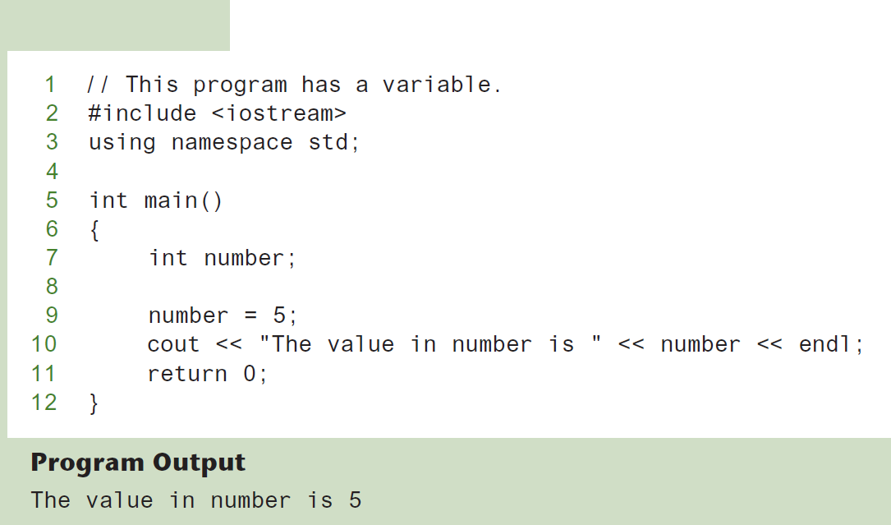
Variable Definition and Assignment
Program 2-8
Variable Definition
Variable Assignment

Slide 22
Literals
Literal: a value that is written directly into a program’s code.
"hello, there" (string literal)
12 (integer literal)
Values are assigned to variables
Variables are associated with a space in RAM
Values are stored in that assigned space

Slide 23
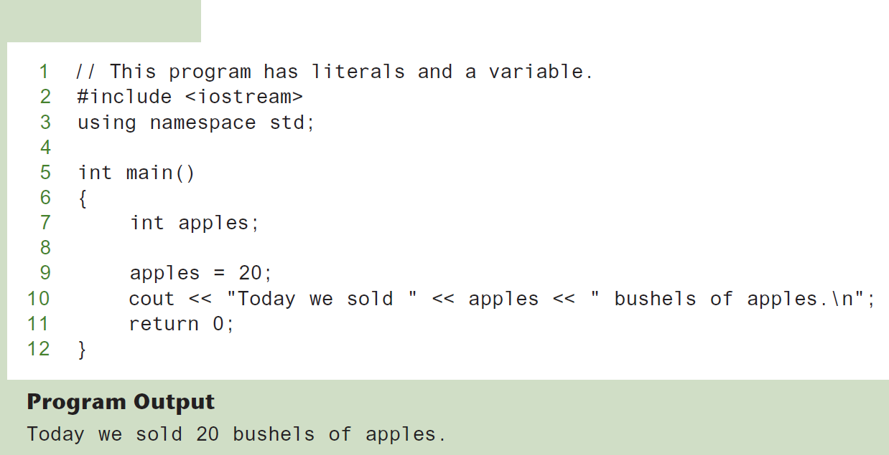
Integer Literal
Program 2-10
20 is an integer literal

Slide 24
String Literals
Program 2-10
These are string literals
Be sure to not put quotes around the variable – it will be interpreted as a string literal.

Slide 25
2.5
Identifiers

Slide 26
Identifiers
An identifier is a programmer-defined name for some part of a program: variables, functions, etc.

Slide 27
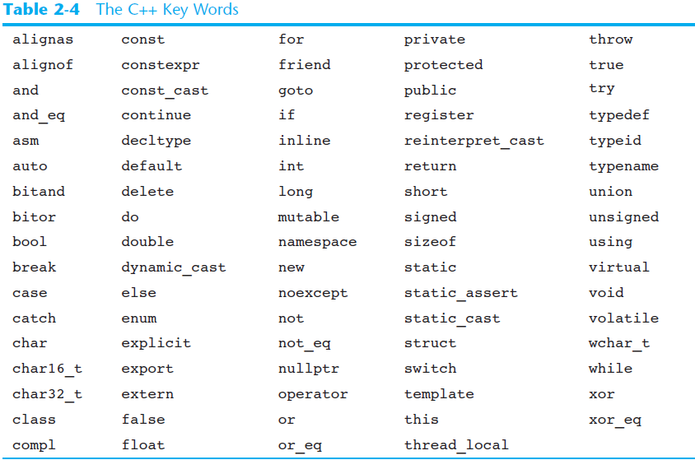
C++ Key Words
You cannot use any of the C++ key words as an identifier. These words have reserved meaning.

Slide 28
Variable Names
A variable name should represent the purpose of the variable. For example: itemsOrdered The purpose of this variable is to hold the number of items ordered.

Slide 29
Identifier Rules
Any name will work for an identifier with the following rules:
The first character of an identifier must be an alphabetic character or and underscore ( _ )
Cannot begin with a number
After the first character you may use alphabetic characters, numbers, or underscore characters.
Upper- and lowercase characters are distinct

Slide 30
Valid and Invalid Identifiers
IDENTIFIER
totalSales
total_Sales
total.Sales
4thQtrSales
_Sales_
totalSale$
VALID?
Yes
Yes
No
No
Yes
No
REASON IF INVALID
Cannot contain “ . ”
Cannot begin with digit
Cannot contain “ $ ”

Slide 31
2.6
Integer Data Types

Slide 32
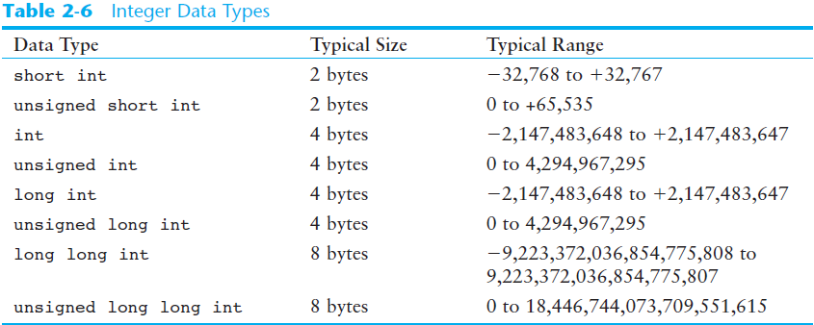
Integer Data Types
Integer variables can hold whole numbers such as 12, 7, and -99.
Exact values vary based on computer architecture
Notes:
SHORT - Using 2 bytes (8 bits each, 16 bits total): 1st bit indicates sign, other 15 bits indicate number $2^{15}=32,$768
UNSIGNED SHORT – Uses all 16 bits for the number $2^{16}=65,536$
Etc.

Slide 33
Defining Variables
Variables of the same type can be defined
On separate lines:
int length;
int width;
unsigned int area;
On the same line:
int length, width;
unsigned int area;
Variables of different types must be in different definitions

Slide 34
Integer Literals
An integer literal is an integer value that is typed into a program’s code. For example: itemsOrdered = 15; In this code, 15 is an integer literal.

Slide 35
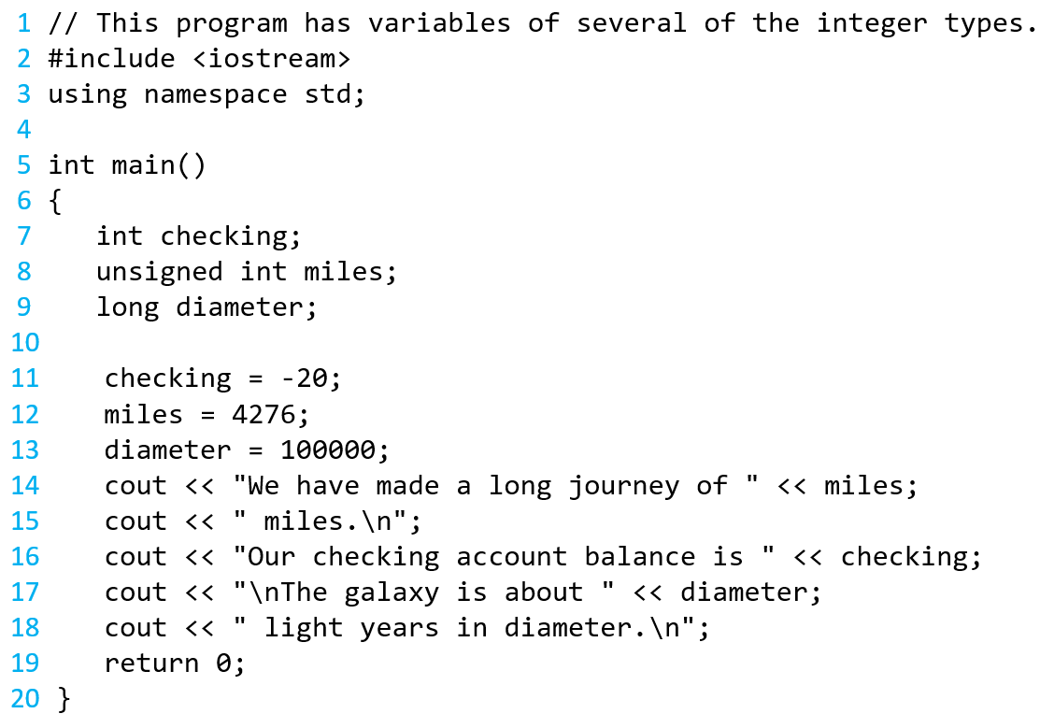
Integer Types in Program 2-11
This program has three variables:
checking, miles, and diameter

Slide 36
Integer Literals in Program 2-11
Integer Literals

Slide 37
Integer Literals
Integer literals are stored in memory as ints by default
To store an integer constant in a long memory location, put ‘L’ at the end of the number: 1234L
To store an integer constant in a long long memory location, put ‘LL’ at the end of the number: 324LL
Constants that begin with ‘0’ (zero) are base 8: 075
Constants that begin with ‘0x’ are base 16: 0x75A

Slide 38
2.7
The char Data Type

Slide 39
The char Data Type
Used to hold characters or very small integer values
Usually 1 byte of memory
Numeric value of character from the character set is stored in memory:
www.ascii-code.com ASCII code also in Appendix A
CODE:
char letter;
letter = 'C';
MEMORY:
letter
67

Slide 40
Character Literals
Character literals must be enclosed in single quote marks. Example: 'A'

Slide 41
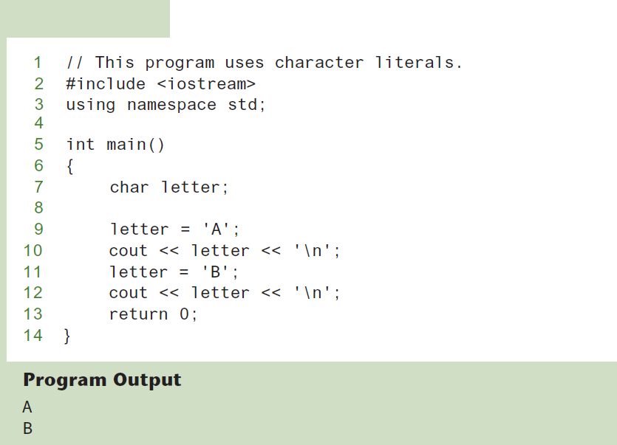
Character Literals
Program 2-15

Slide 42
Character Strings
A series of characters in consecutive memory locations:
"Hello"
Stored with the null terminator, \0, at the end:
Comprised of the characters between the " "
H | e | l | l | o | \0

Slide 43
Difference between char and string
A character is a single character, and only takes 1 byte of memory
Surrounded by single quotes
‘A’
A string is a series of characters and take up a consecutive sequence of bytes in memory
Surrounded by double quotes
Requires a null character to depict the end of the string
“A”
A
A | \0

Slide 44
2.8
The C++ string Class

Slide 45
The C++ string Class
Special data type supports working with strings
#include <string>
Can define string variables in programs:
string firstName, lastName;
Can receive values with assignment operator:
firstName = "George";
lastName = "Washington";
Can be displayed via cout
cout << firstName << " " << lastName;

Slide 46
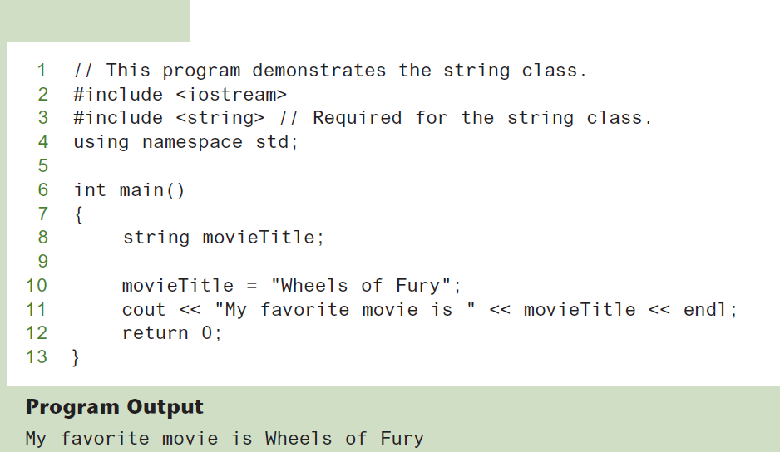
The string Class
Program 2-16

Slide 47
2.9
Floating-Point Data Types

Slide 48
Floating-Point Data Types
The floating-point data types are: float double long double
They can hold real numbers such as:
12.45 -3.8
Stored in a form similar to scientific notation
All floating-point numbers are signed

Slide 49
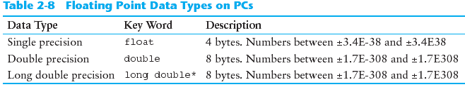
Floating-Point Data Types
The floating-point data types are: float double long double

Slide 50
Floating-Point Literals
Can be represented in
Fixed point (decimal) notation:
31.4159 0.0000625
Scientific Notation
3.14159 * 10¹ 6.25 * 10⁻⁵
E notation:
3.14159E1 6.25e-5
Are double by default
Can be forced to be float (3.14159f) or long double (0.0000625L)

Slide 51
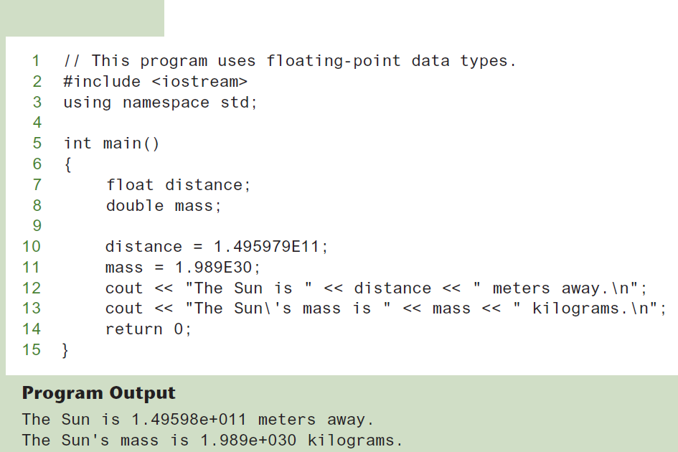
Floating-Point Data Types in Program 2-16
Program 2-17

Slide 52

Floating-Point E indicator
The E01 in 3.14159E01 mean $∗{10}^{01}$
This can be uppercase E or lowercase e
The following are all equivalent:
1.5 * 10⁴ 15000
1.5E04 1.5e04
1.5E4 1.5e4
1.5E+04 1.5e+04
1.5E+4 1.5e+4

Slide 53
What would the following code do?
int number
number = 7.5;
number = ???
Number = 7

Slide 54
2.10
The bool Data Type

Slide 55
The bool Data Type
A Boolean variable represents values that are true or false
bool variables are stored as small integers
false is represented by 0, true by 1:
bool allDone = true;
bool finished = false;
allDone
finished
1
0

Slide 56
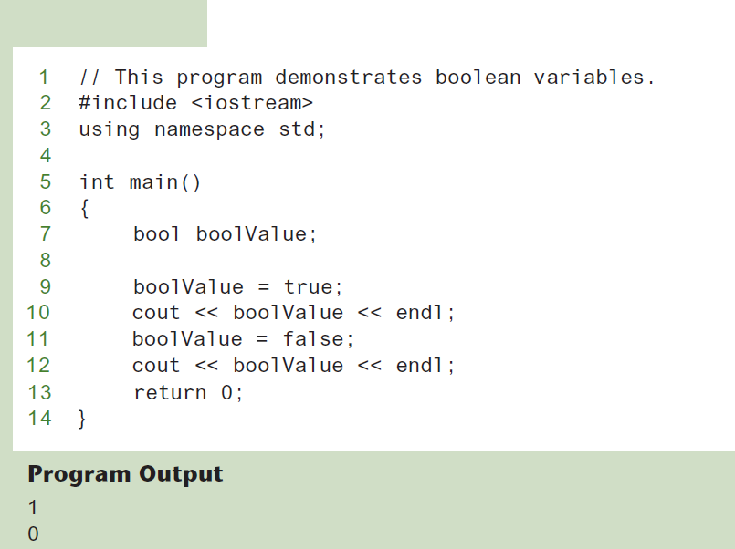
Boolean Variables
Program 2-18

Slide 57
2.11
Determining the Size of a Data Type

Slide 58
Determining the Size of a Data Type
The sizeof operator gives the size of any data type or variable:
double amount;
cout << "A double is stored in "
<< sizeof(double) << "bytes\n";
cout << "Variable amount is stored in "
<< sizeof(amount)
<< "bytes\n";

Slide 59
2.12
Variable Assignments and Initialization

Slide 60
Variable Assignments and Initialization
An assignment statement uses the = operator to store a value in a variable. item = 12;
This statement assigns the value 12 to the item variable.

Slide 61
Assignment
The variable receiving the value must appear on the left side of the = operator.
This will NOT work: // ERROR! 12 = item;

Slide 62
Variable Initialization
To initialize a variable means to assign it a value when it is defined:
int length = 12;
Can initialize some or all variables:
int length = 12, width = 5, area;

Slide 63
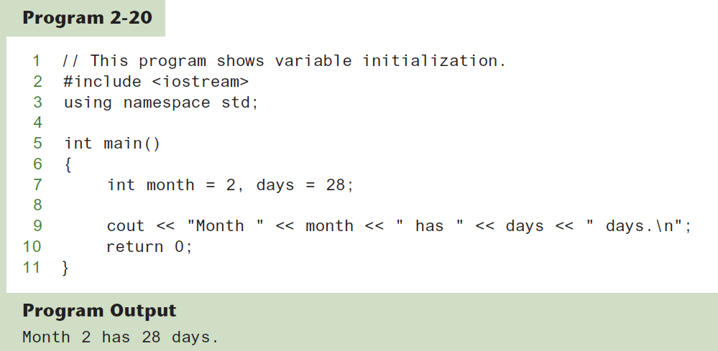
Variable Initialization

Slide 64
Declaring Variables With the auto Key Word
C++ 11 introduces an alternative way to define variables, using the auto key word and an initialization value. Here is an example:
auto amount = 100;
The auto key word tells the compiler to determine the variable’s data type from the initialization value.
auto interestRate= 12.0;
auto stockCode = 'D';
auto customerNum = 459L;
int
double
char
long

Slide 65
2.13
Scope

Slide 66
Scope
The scope of a variable: the part of the program in which the variable can be accessed
A variable cannot be used before it is defined

Slide 67
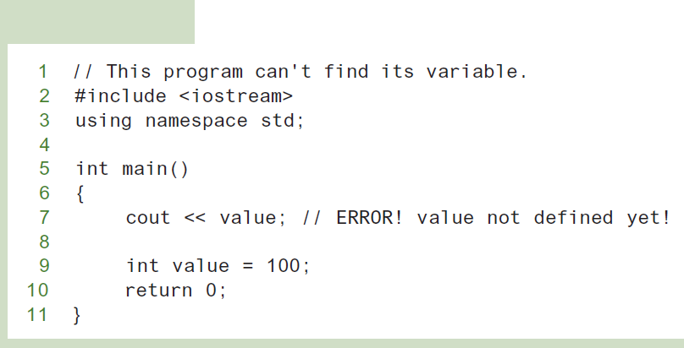
Variable Out of Scope
Program 2-21

Slide 68
2.14
Arithmetic Operators

Slide 69
Arithmetic Operators
Used for performing numeric calculations
C++ has unary, binary, and ternary operators:
unary (1 operand) -5
binary (2 operands) 13 - 7
ternary (3 operands) exp1 ? exp2 : exp3
Notes:
The minus sign in front of a literal negates the number. So, this is the negation operator.

Slide 70
Binary Arithmetic Operators
SYMBOL | OPERATION | EXAMPLE | VALUE OF ans
+ | addition | ans = 7 + 3; | 10
- | subtraction | ans = 7 - 3; | 4
* | multiplication | ans = 7 * 3; | 21
/ | division | ans = 7 / 3; | 2
% | modulus | ans = 7 % 3; | 1
The modulus operator only works with integers

Slide 71
A Closer Look at the / Operator
/ (division) operator performs integer division if both operands are integers
cout << 13 / 5; // displays 2
cout << 91 / 7; // displays 13
If either operand is floating point, the result is floating point
cout << 13 / 5.0; // displays 2.6
cout << 91.0 / 7; // displays 13.0

Slide 72
A Closer Look at the % Operator
% (modulus) operator computes the remainder resulting from integer division
cout << 13 % 5; // displays 3
% requires integers for both operands
cout << 13 % 5.0; // error

Slide 73
2.15
Comments

Slide 74
Comments
Used to document parts of the program
Intended for persons reading the source code of the program:
Indicate the purpose of the program
Describe the use of variables
Explain complex sections of code
Are ignored by the compiler

Slide 75
Single-Line Comments
Begin with // through to the end of line:
int length = 12; // length in inches
int width = 15; // width in inches
int area; // calculated area
// calculate rectangle area
area = length * width;

Slide 76
Multi-Line Comments
Begin with /*, end with */
Can span multiple lines:
/* this is a multi-line
comment
*/
Can begin and end on the same line:
int area; /* calculated area */

Slide 77
2.16
Named Constants

Slide 78
Named Constants
Named constant (constant variable): variable whose content cannot be changed during program execution
Used for representing constant values with descriptive names:
const double TAX_RATE = 0.0675;
const int NUM_STATES = 50;
Often named in uppercase letters

Slide 79
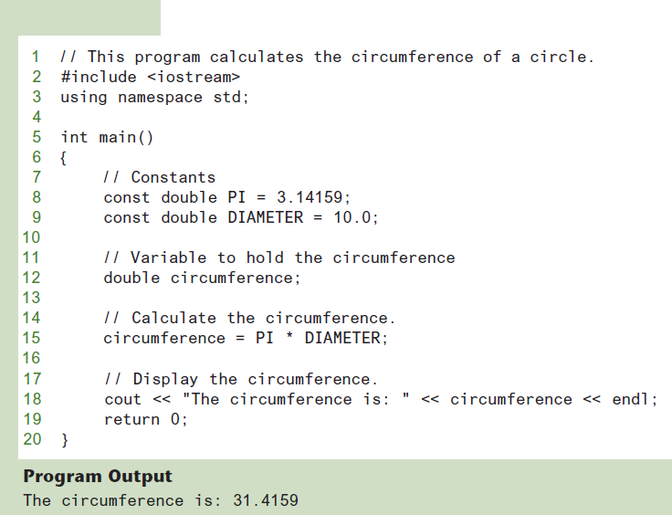
Named Constants in Program 2-28
Program 2-29

Slide 80
2.17
Programming Style

Slide 81
Programming Style
Affects the readability of the source code
The visual organization of the source code
Includes the use of spaces, tabs, and blank lines
Uses comments
Does not affect the syntax of the program
It is also a good idea to provide information for the user

